Slide 1
Re-Imagining Education and Teaching
David Nelson

Slide 2
Agenda
Introduction & Background
Education Without Restrictions
Sharing Our Visions
Examples of Redesigns
Possible Next Steps
Benefits and Concluding Thoughts

Slide 3
Who Am I and Why Am I Here?
Arizona Native in the Midwest
Born and Raised in Phoenix
Worked in Academic Development for 15 years, last 10 at Purdue
Background and degrees in history, currently teach in Honors College, support instructors at Purdue and publish in SoTL
Involved with IMPACT - Purdue’s Course Transformation program for last 8 years
Notes:
32nd street and the Canal
North High School
Took my first and only calculus course at SCC

Slide 4
IMPACT – Purdue Academic Course Transformation
Faculty Learning Community
Goal of creating student-centered learning environments
Over 500 Courses and 300 Instructors
Extensive assessment and evaluation component, over 50,000 student data points
I’m an agnostic
WHAT you do is far less important than HOW you do it
Can modify environment to increase likelihood of learning
Notes:
13-week FLC
All ten colleges represented
Agnostic – not here to preach, but to facilitate initial discuss and share my experiences and those of Purdue

Slide 5
If you had a Magic Wand –
http://bitly.com/GCCInnovate

Slide 6
Example Redesigns from Purdue
Environmental Engineering & Sustainability
Project-Based Learning
Semester-long Project with Drafts
“Messy” Problems
Teams (CATME.ORG Tool)
Peer Evaluation
Peer Undergraduate Mentors

Slide 7
Example Redesigns from Purdue
Intro Psychology & Intro Statistics
Flip the Classroom
Pre-recorded lectures, one weekly class Students work in groups/teams on problems or discussion topics
Instructor rotates among tables
Benefits from some dedicated and timely out of class quizzes
Notes:
Statistics uses in-lecture quizzes
Psychology has short videos from subject matter experts in the department
Gundlach et al

Slide 8
Example Redesigns from Purdue
Leadership in Nursing
Community-Based Learning
Simulation
Professionals in the Classroom
Clinical Exposure
Creation of Leadership Plan
Notes:
Statistics uses in-lecture quizzes
Psychology has short videos from subject matter experts in the department

Slide 9
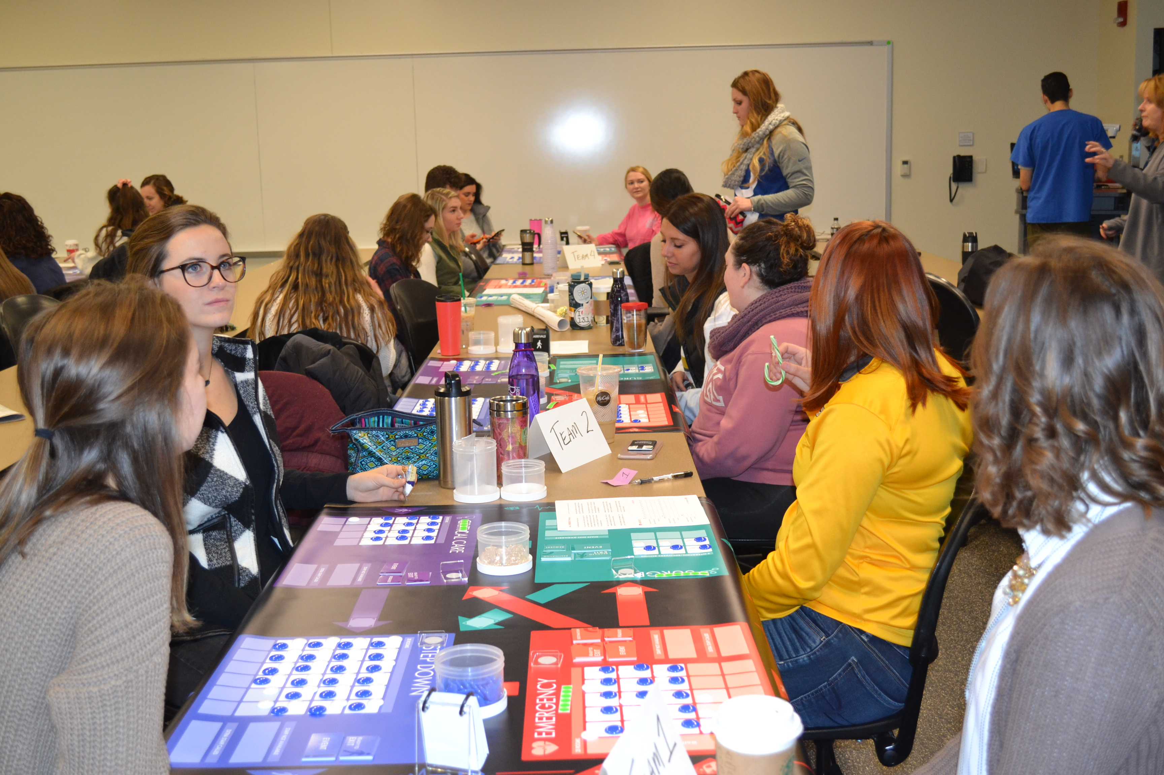

Slide 10
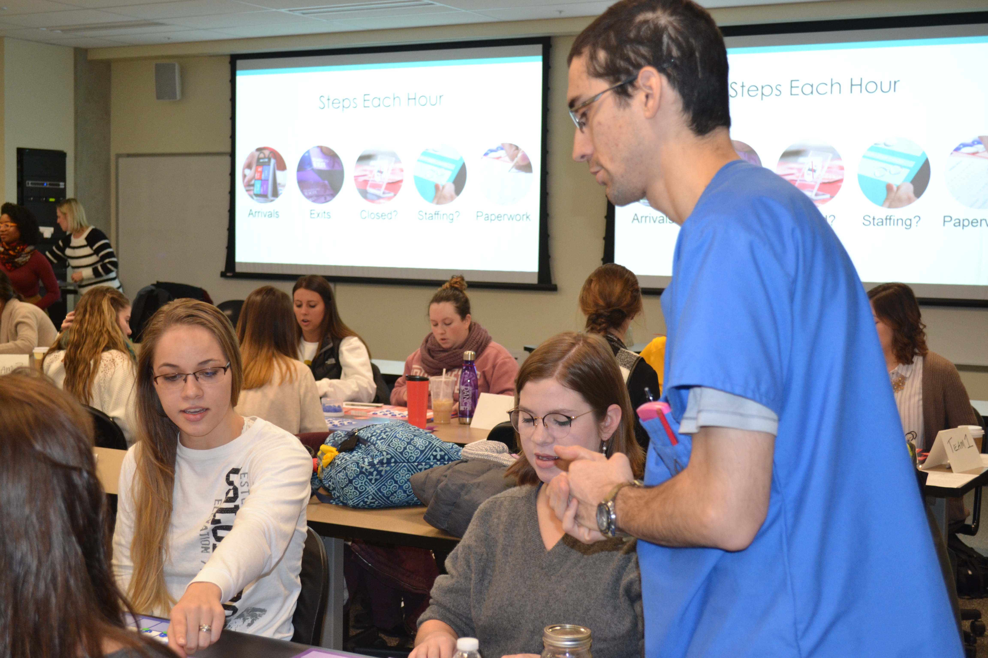

Slide 12
Example Redesigns from Purdue
Problem-Based Learning and Learning Communities
Disciplinary Skills over Extended Period (Dunlap, 2005)
Commitment of Students to Retain Focus (Savery, 2015)
Benefit from Scaffolding (Hmelo-Silver et al, 2007)
Notes:
Statistics uses in-lecture quizzes
Psychology has short videos from subject matter experts in the department

Slide 13
Example Redesigns from Purdue
Problem-Based Learning and Learning Communities
Demonstrated Learning Gains in Several Fields (Yadav et al, 2011; Gallagher & Stepien, 1996)
Higher Grades for Advanced Students (Zhao et al, 2007)
Notes:
Statistics uses in-lecture quizzes
Psychology has short videos from subject matter experts in the department

Slide 14
Innovating at GCC
Possible Next Steps
Innovative Cohorts
Self-Help Resources
CTLE & Librarians
Individually-funded Projects (Innovation Fund)

Slide 15
Innovation
Why Spend Time Doing This?
Critical Thinking Skills and Student Performance
Intentionality
Student Engagement

Slide 16
Innovation
Why Spend Time Doing This?
Critical Thinking Skills & Performance
Lower DFW Rates
Improved Performance on Higher-Order Exam Questions

Slide 17
Innovation
Why Spend Time Doing This?
Intentionality and Student Engagement
”Reducing the chanciness of serendipitous learning” (Ball & Forzani, 2009)
Introduces possibility of provoking student misunderstandings

Slide 18
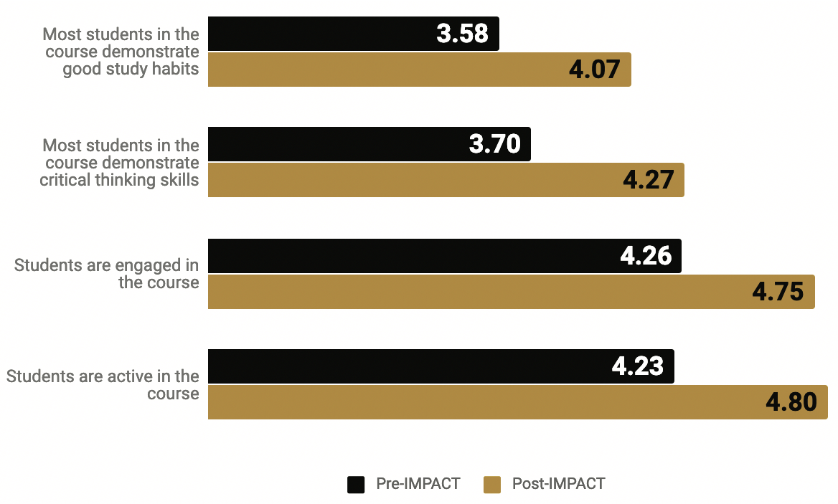
Instructor Perceptions – Before and After
Notes:
Can mention Course Design Plan after, but cut slide

Slide 19
Innovation
Opportunity Costs & Suggestions
Innovation Takes Time
Can Be Uncomfortable
Students May Have Different Expectations
Iterate and Start Small

Slide 20
Thank You

